Slide 1
Microservices and DevOps
DevOps and Container Technology
Agile Development – an Opiniated Guide
Henrik Bærbak Christensen

Slide 2
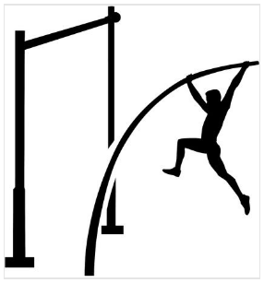
All seasoned developers...
... And I do not spend all my time developing, so...
Who am I to teach you how to develop software?
However, often I see this:
  I will just code these two SQL
  statements, add a table, aah – OK
  I also introduce the table init seq;
  wait, I have this code somewhere;
  Yeah, I will just generalize, and
  update all call sites, Hey – this
  must be a bug here...

Slide 3

That is – take large steps
When asked, people says
  It is much faster!
Falling fifty times is not faster!

Slide 4

Take small steps...
One of the four test-driven development principles:
  Take small steps
Use the ladder, not the vaulting pole. – Henrik Bærbak

Slide 5

Not Unknown Phenomenon
Build support code to help you build strong code!
  Like taking the ladder/stairs – slow but steady, and you do not fall down and hurt yourself (too badly)!
Scaffolding Code

Slide 6
The Code Perspective
Enough Metaphoric Speak

Slide 7
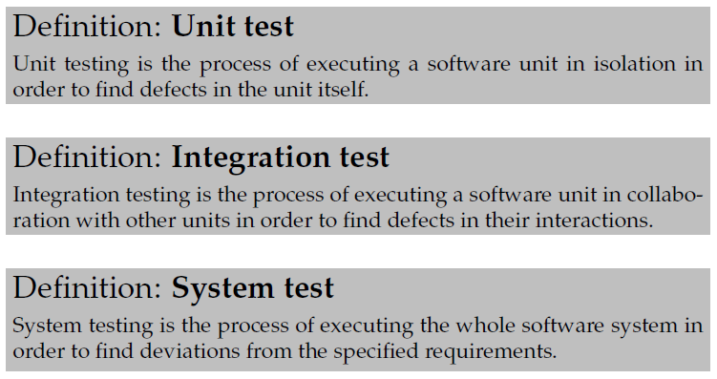
A Developer’s Scaffolding
DevOps relies on testing! Get used to it!
... And at all levels...
Testing is scientific
process:
  Hypothesis
    Write test
  Experiment
    Execute
  Conclusion
    Pass/Fail

Slide 8
From SkyCave
Our present ‘monolith’ SkyCave architecture
Starting from the Bottom:
The Storage layer...
Presentation Layer / ‘cmd’
Application Layer / ‘daemon’
Storage Layer / Database
<<i>>
CaveStorage

Slide 9
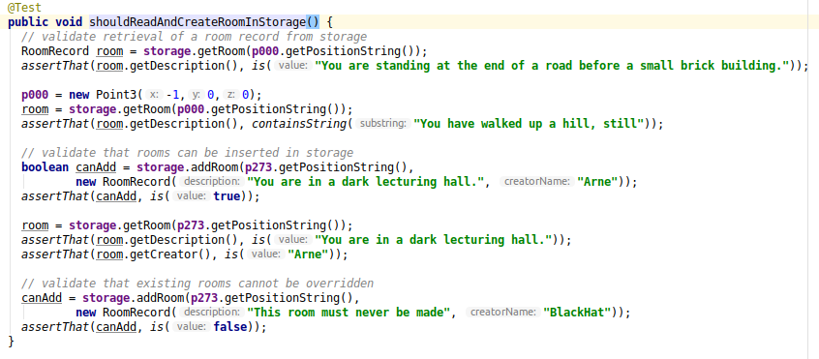
Make Tests!
Hypothesis: Storage can Create and Read rooms
TestRoomPlayerStorage

Slide 10
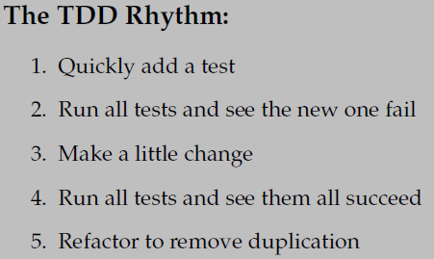

What??? You have no DB!
I am a TDD guy
  Top-down approach
  Code the API before the
  implementation!!!
So I quickly add test
See it fail, and then...
  I do not start a Microsoft SQL Server 2017 and start hacking SQL statements... Why? Because my tests would not be automatic!

Slide 11
Unit Tests are Fast!
Testing against a real DB is an Integration test. Requires a lot of setup to start a DB, wipe its contents, shut it down again.
It is to slow when you run your unit tests twice every minute!!! And you do, right?
So I use Test doubles – replacements for the real depended-on-unit that acts like it but are fast, lightweight, and so easy to code that they contain no errors!

Slide 12

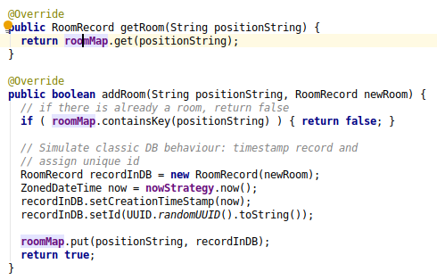
Fake Object
Use a HashMap or ? Or ? as DB table!

Slide 13

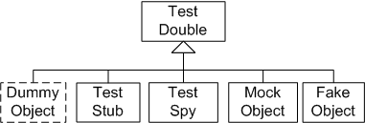
Meszaros
Test doubles makes your software
testable, because they
  Break dependencies on ‘heavy objects’
    Databases, remote services,
  Breaks dependency chains to isolate the
  unit-under-test

Slide 14
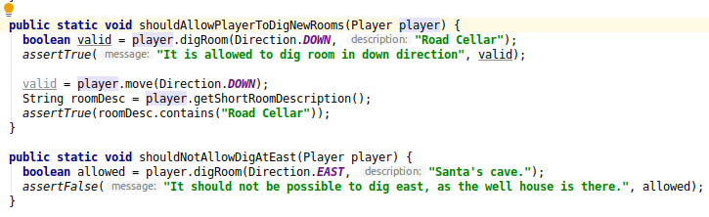
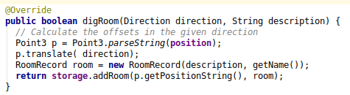
Testing at the Application Layer
Hypothesis: PlayerServant can dig new rooms
  Fast development, as no setup is required

Slide 15
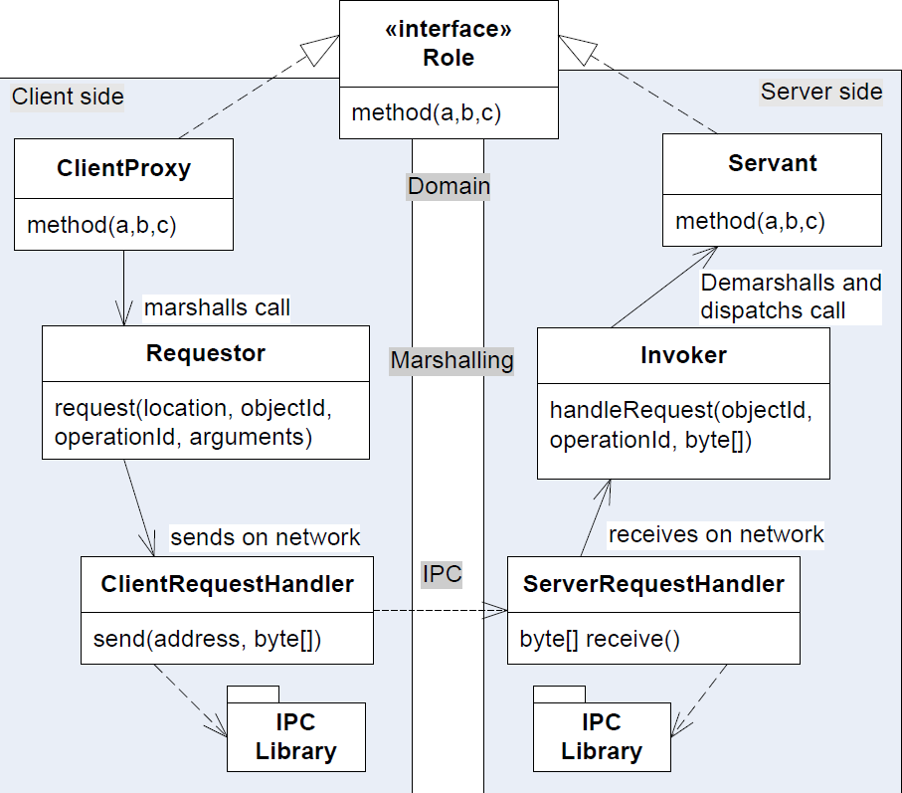
Other Example
SkyCave is a distributed client-server system...
Hypothesis: PlayerProxy can dig new rooms
Actually, it is the same test-
case!
  Refactored into a
  ‘CommonPlayerTest’

Slide 16
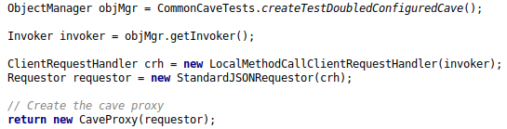
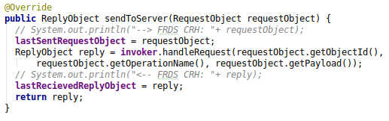
Fake Object IPC
IPC purpose: Get data from client to server
  We can use a test double instead!
LocalCRH

Slide 17
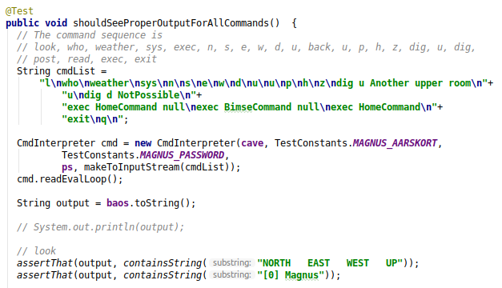
Testing at the Presentation Layer
We can even move the testing to the UI layer now
  ”Automated System Testing”

Slide 18
Compare...
Comparing to a non-test-doubled architecture
  Start the database, wipe its contents, run the init script to fill in the default tables, update the server’s config file with the proper (ip,port) of the database, start the server, start the daemon, try to dig a new room to the north, validate that it worked ok, ...
Large Aarhus based company war-story
  1.000 hours of manual test before release...

Slide 19
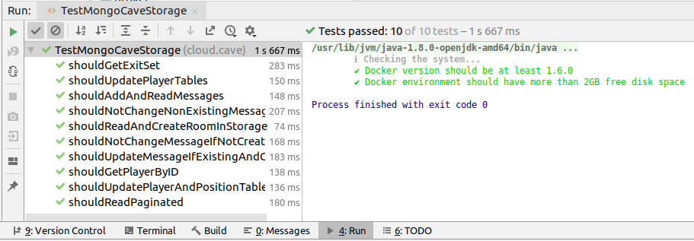
And that is not all...
Remember the low level tests test at the storage level?
  Hypothesis: Storage can Create and Read rooms
  Reuse them for service tests using the real database!

Slide 20
Cost Benefit Analysis
Costs:
  I have to program to an interface
    To have two or more implementations of the CaveStorage
  I do have to develop and maintain the ‘FakeCaveStorage’
    12-15 methods with a lot of hashMap manipulations (260 LOC)
  Dependency Injection is required
    To control which implementation of CaveStorage to use
Benefits
  I am forced to program to an interface ☺
  I am forced to use dependency injection ☺

Slide 21
Cost Benefit Analysis
Benefits ...
  I have most of my code under fast test execution
  I can reuse my test cases to develop real-service code in the service tests

Slide 22
The Ladder, not the Vaulting Pole
Take small steps by
  Building test cases to ensure you do not fall
  External services/modules replaced by test doubles
    That are covered by test cases
  ... That you reuse for the real
  interaction code...

